Slide 1


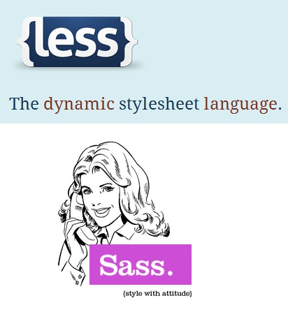
SASS & LESS
Syntactically Awesome StyleSheets
Dynamic StyleSheet Language
Svetlin Nakov
Technical Trainer
www.nakov.com
Software University
http://softuni.bg

Slide 2


Table of Contents
SASS Overview
Working with SASS
Using the Visual Studio Plugins
SASS Features
Nesting
Variables
Mixins
Selector Inheritance
LESS Overview

Slide 3
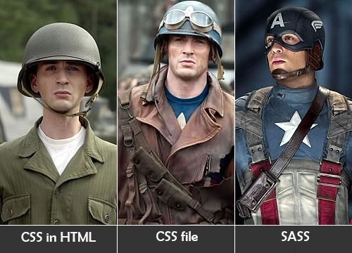
SASS Overview

Slide 4

SASS
Syntactically Awesome Stylesheets (SASS)
Extension of CSS
Makes CSS coding much easier and organized
Translates to pure CSS (server-side)
No slowdown at the client
SASS powers the CSS coding through
Variables (define once, use at many places)
Mixins (reusable functions with parameters)

Slide 5

SASS Tools
SASS has many implementations (http://sass-lang.com/install)
Usually available directly in your IDE as a plugin
Originally SASS was a Ruby-based tool
Install Ruby (e.g. from http://rubyinstaller.org)
Install the "SASS" gem module (gem install sass)
SASS is natively supported in Visual Studio (from 2013 U2)
Web Essentials is recommended for better support
http://vswebessentials.com

Slide 6

Coding SASS in Visual Studio
Live Demo

Slide 7

SASS Features

Slide 8
SASS Selector Nesting
body {
font: normal 16px arial;
color: #fff;
background-color: #011b63;
div {
font-size: 2.3em;
font-weight: bold;
ul li {
list-style-type:none;
a {
text-decoration:none;
color:white;
}
}
}
}
body {
font: normal 16px arial;
color: #fff;
background-color: #011b63;
}
body div {
font-size: 2.3em;
font-weight: bold;
}
body div ul li {
list-style-type: none;
}
body div ul li a {
text-decoration: none;
color: white;
}
SASS
Compile

Slide 9
SASS Selector Nesting
Selectors can also reference themselves by the & symbol:
body {
font: normal 16px arial;
color: #fff;
background-color: #011b63;
a {
text-decoration:none;
color:white;
&:hover {
text-decoration:underline;
color:tomato;
}
}
}
body {
font: normal 16px arial;
color: #fff;
background-color: #011b63;
}
body a {
text-decoration: none;
color: white;
}
body a:hover {
text-decoration: underline;
color: tomato;
}
SASS
Compile

Slide 10
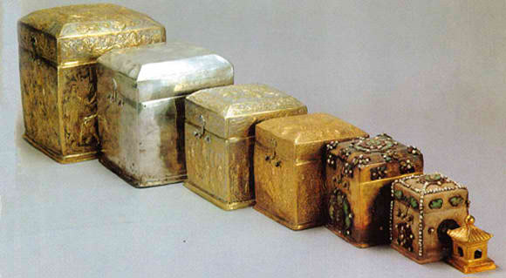
Selector Nesting in SASS
Live Demo

Slide 11
SASS Variables
SASS supports variables
Using the $ (dollar) symbol
E.g. $text-color, $font-size
Variables have name and hold value
Can be defined outside the selector, always up!
Can be used to store colors, size, etc…
Usable to set one element many times (“code reuse”)
$text-color: tomato;

Slide 12
SASS Variables – Example
$color-non-visited: black;
$color-visited: tomato;
body {
a {
color: $color-non-visited;
&:visited {
color: $color-visited;
}
}
}
body a {
color: black;
}
body a:visited {
color: tomato;
}
SASS
Compile

Slide 13
SASS Variables-Interpolation
SASS variables can be inserted as CSS properties
Using #{$variable}
$border-side: top;
$border-color: tomato;
$border-style: ridge;
$border-width: 15px;
li {
border-#{$border-side}:
$border-width $border-style $border-color;
}
border-top: 15px ridge tomato;

Slide 14

SASS Variables
Live Demo

Slide 15

Mixins

Slide 16

Mixins: Reusable Blocks of SASS Code
Mixins are kind of developer-defined functions
Allow reusing blocks of code several times
Two kind of mixins
Parameterless
Render the same styles every time
With parameters
Render styles based on some input parameters
E.g. gradients, borders, etc…

Slide 17
Defining and Using Mixins
Defining a mixin (without parameters):
Using (including) a mixin:
@mixin default-element-border {
border: 1px solid black;
background: tomato;
border-radius: 10px;
}
ul li {
@include default-element-border;
}

Slide 18
Mixins with Parameters
Mixins can also be defined with parameters
Defined like in C# / Java / JS and can have default value
@mixin opacity-maker($value) {
opacity: $value;
filter: alpha(opacity=($value*100));
zoom: 1;
}
@mixin box-initialize($border:none,$background:rgba(0,0,0,0.7),$size:200px) {
width: $size;
height: $size;
border: $border;
background: $background;
padding: 15px;
}

Slide 19

SASS Mixins
Live Demo

Slide 20
SASS Selector Inheritance
We can inherit selectors in SASS with @extend
.default-border {
border: 3px solid black;
background: tomato;
border-radius: 8px;
}
.dotted-border {
@extend .default-border;
border-style: dotted;
}
.default-border, .dotted-border {
border: 3px solid black;
background: tomato;
border-radius: 8px;
}
.dotted-border {
border-style: dotted;
}
SASS
Compile

Slide 21
Selector Inheritance
Live Demo

Slide 22
Importing SASS Files
SASS files can be imported in other SASS files
Like CSS files can be imported in CSS files
Use the @import directive
SASS defines partials
i.e. SASS files that are meant to be imported
Just use prefix _ (underscope)
@import '_gradients.scss'
// and can use the items from _gradients.scss

Slide 23


Import SASS files
Live Demo

Slide 24
LESS

Slide 25
LESS
LESS is CSS preprocessor, similar to SASS
http://lesscss.org
Can be compiled both in the browser at the server
Using a LESS parser written in JavaScript
LESS features include
Nesting selectors
Variables
Mixins
Color editing functions

Slide 26
LESS – Example
@base-color: green;
@base: 5%;
@filler: @base * 2;
@other: @base + @filler;
.example {
color: #888 / 4;
background-color: @base-color + #111;
height: 100% / 2 + @filler;
}
.example {
color: #222222;
background-color: #119111;
height: 60%;
}
LESS
Compile

Slide 27
Using LESS at the Client
LESS can be compiled at the client-side (in the Web browser):
Using the JavaScript preprocessor less.js
Note: client-side LESS compilation slows-down your site!
If using Visual Studio, you should add a MIME type for the LESS in your site's Web.config (otherwise .less files can't be served)
<link rel="stylesheet/less" type="text/css" href="styles.less"/>
<script src="less.js"></script> //after the less link
<configuration> <system.webServer> <staticContent>
<mimeMap fileExtension=".less" mimeType="text/css" />
</staticContent> </system.webServer> </configuration>

Slide 28
Parsing LESS on the Server
LESS can be compiled on the server
Using the client approach and copy the CSS
Not good enough, lots of copy-pastying
Using Node.js to do the parsing
Better solution – the parsing is automated
Using plugins for your favorite Web editor
Web Essentials for Visual Studio (or Visual Studio 2003 U2+)
LESS and LESS2CSS for Sublime Text

Slide 29

Summary
SASS
Simplifies the CSS development + enables code reuse
SASS support in Visual Studio
Use VS 2013U2 (or later) + Web Essentials
SASS features
Nesting, variables, mixins, inheritance
LESS
Similar to SASS, can be processed client-side

Slide 30
SASS & LESS
https://softuni.bg/courses/web-fundamentals/

Slide 31
License
This course (slides, examples, demos, videos, homework, etc.) is licensed under the "Creative Commons Attribution-NonCommercial-ShareAlike 4.0 International" license
Attribution: this work may contain portions from
"HTML Basics" course by Telerik Academy under CC-BY-NC-SA license
"CSS Styling" course by Telerik Academy under CC-BY-NC-SA license

Slide 32







SoftUni Diamond Partners

Slide 33




Free Trainings @ Software University
Software University Foundation – softuni.org
Software University – High-Quality Education, Profession and Job for Software Developers
softuni.bg
Software University @ Facebook
facebook.com/SoftwareUniversity
Software University @ YouTube
youtube.com/SoftwareUniversity
Software University Forums – forum.softuni.bg

